Slide 1

Workplace Project Breaking Down Silos: Developing a Knowledge Sharing Platform for Internal Business
Callum White – N0897675
Notes:
Hello and welcome to my presentation about my workplace project.

Slide 2


Introduction
Layout:
Benefits of knowledge sharing platform
What’s currently in the market?
Key features and functionalities
Project outline
Steps to implementation
Results/ Survey
Project conclusion
Notes:
Welcome, everyone, to today's presentation on developing a knowledge sharing platform for internal business. In today's fast-paced and rapidly changing business environment, it's more important than ever to break down silos and promote collaboration across teams and departments. By doing so, we can leverage the diverse skills, knowledge, and experience of our employees to drive innovation, solve complex problems, and achieve our business goals.
A knowledge sharing platform can be a powerful tool to facilitate this collaboration and promote the free flow of information and ideas across our organization. In this presentation, we will explore the benefits of developing a knowledge sharing platform, the key features and functionalities to consider, and the steps involved in implementing such a platform. We will also discuss some best practices and lessons learned from other organizations that have successfully implemented knowledge sharing platforms.
Thank you for joining us today, and we hope you find this presentation informative and valuable.

Slide 3

MHR
MHR is a leading HR & Payroll service provider who strives for continuous evolution of its product, which requires mass research be shared across the business.

Slide 4

Silos and ad-hoc sharing methods are causing issues within the business
Notes:
Our business has separate departments that work in silos, leading to communication barriers and duplication of effort.
Departments often rely on ad-hoc sharing methods like email and messaging, which are informal and can result in useful findings being excluded from certain teams.
This lack of collaboration and information sharing can result in missed opportunities, slower decision-making, and decreased innovation.
Developing a knowledge sharing platform can help us break down these silos and promote better collaboration, allowing us to leverage the diverse skills and expertise of our employees to drive innovation and achieve our business goals.

Slide 5
Opportunity Revolutionizing Knowledge Sharing at MHR
Reduce duplication of effort
Increase collaboration and sharing of knowledge between departments
Stimulate idea generation and break down silos
Notes:
MHR as a leading HR service provider
Need for continuous product evolution and knowledge sharing across the business
Existing silos causing harm to company culture and decreasing efficiency
Opportunity to introduce a revolutionary way to share knowledge between departments
Immediate benefits: reduced duplication of effort
Long-term benefits: increased collaboration, knowledge sharing, and idea generation between departments, leading to reduced silos

Slide 6
Knowledge Sharing Platform for Collaborative Research
Enables real-time communication and knowledge sharing among departments
Reduces duplication of effort and exclusion of departments from useful findings
Departments involved: Product Design, UX, Research, Marketing
Items shared: links, papers, books, videos, summaries, analysis
Current ad-hoc sharing methods: email, Teams, SharePoint, OneDrive, People First communities, Miro
Notes:
Enabling real-time communication and knowledge sharing among departments can help to break down silos and promote better collaboration, leading to increased innovation and efficiency.
A knowledge sharing platform can reduce duplication of effort and help to ensure that all departments have access to useful findings, regardless of their level of involvement in the original research or discovery.
Several departments are involved in the knowledge sharing process, including Product Design, UX, Research, and Marketing, highlighting the cross-functional nature of this initiative.
The types of items shared through the knowledge sharing platform include links, papers, books, videos, summaries, and analysis, representing a diverse range of knowledge sources and formats.
Current ad-hoc sharing methods like email, Teams, SharePoint, OneDrive, People First communities, and Miro can be helpful, but they are not ideal for ensuring that all departments have access to the same information in a timely and efficient manner. A knowledge sharing platform can help to streamline this process and ensure that knowledge is shared more equitably and effectively.

Slide 7

Systems study

Slide 8
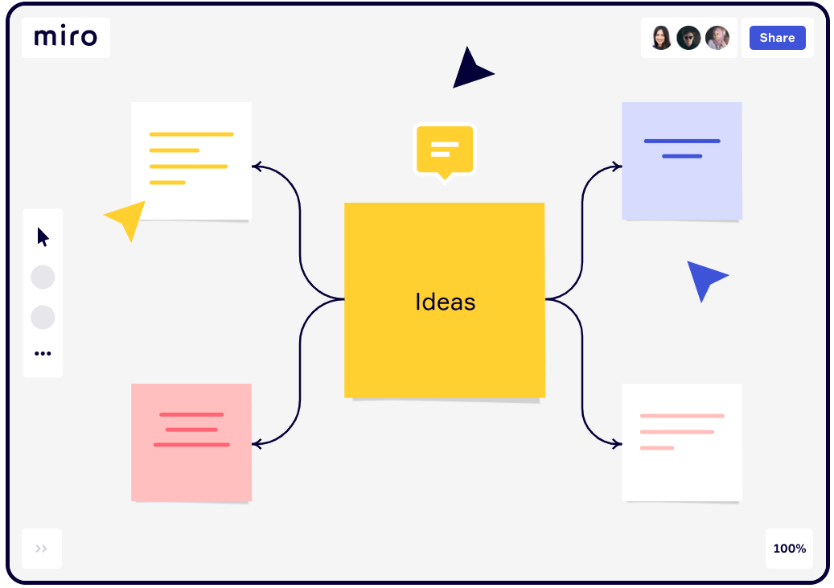
Miro board
Collaborative Digital Whiteboard
Simple to Use
Key Features:
Object arrangement
Note-making capabilities
Online chat and embedded videocalls
Facilitates seamless collaboration and communication.
(Innovation training (2021))

Slide 9
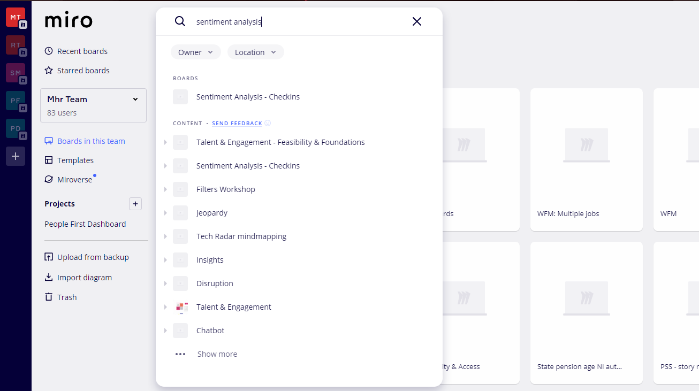
Miro board limitations
Unmanaged boards can become unwieldy
Limited structures or templates for content
Difficulties in returning to existing boards
Challenges in analysing and reporting on knowledge content
Lack of comprehensive searching capabilities within board content
Manual navigation through multiple boards to find desired information
Time-consuming and inefficient process for accessing content

Slide 10

Live demo of Miro board
Live demo of Miro board within MHR

Slide 11
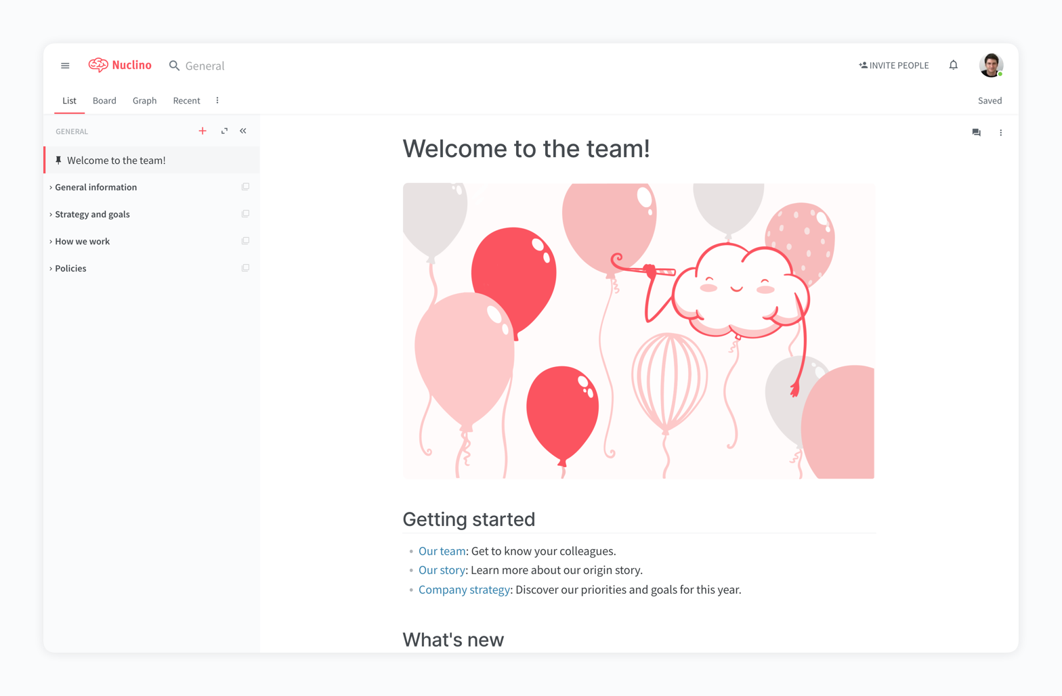
Nuclino
Real-time document sharing and editing
Knowledge management and collaboration platform
Effective search function for rapid and relevant results
Highlighted phrases in search results for easier information retrieval
Simplifies the process of locating desired information
(Marketing tools you can use 2022 (2022))

Slide 12
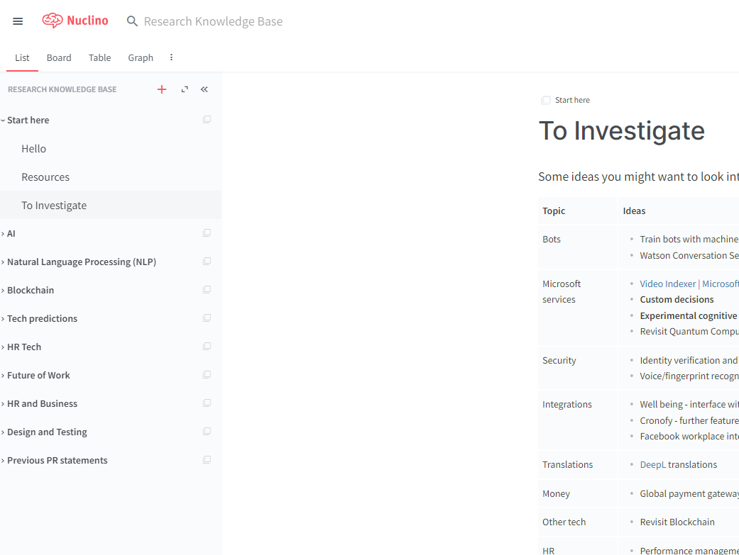
Nuclino limitations
External infrastructure:
Operates outside traditional business infrastructure
Raises concerns about sharing internal and confidential content
Poses data privacy and security risks
Pricing structure:
£4.00 per user per month
Can be a significant constraint, especially for company-wide implementation
Costs can quickly accumulate, impacting budget and accessibility
Impact on collaboration and knowledge sharing:
High implementation costs may limit access for all employees
Hinders internal communication and restricts access for teams and departments

Slide 13
Live demo of Nuclino
Live demo of Nuclino within MHR

Slide 14
Results of analysis
Miro:
Potential for becoming unwieldy and difficult to navigate without proper management
Nuclino:
Operates outside the traditional business infrastructure, raising data privacy and security concerns
Considerations:
Understanding these limitations is crucial in selecting the most suitable platform for knowledge management and collaboration needs.
Notes:
Analysis of Limitations:
Both Miro and Nuclino have certain limitations that need to be considered when evaluating them for knowledge management and collaboration purposes.
Miro:
Potential for becoming unwieldy and difficult to navigate without proper management.
Limited structures and templates for organizing content, which may not align with desired knowledge resource management.
Lack of advanced search capabilities within the board's content, leading to time-consuming and inefficient manual navigation through multiple boards.
Nuclino:
Operates outside the traditional business infrastructure, raising concerns about data privacy and security.
Pricing structure at £4.00 per user per month can be a constraint, particularly for company-wide implementation.
High implementation costs may limit access for all employees, hindering collaboration and knowledge sharing.
Both platforms have their limitations, but they differ in terms of the nature of their constraints. Miro's limitations primarily relate to board management and content organization, while Nuclino's limitations revolve around external infrastructure and pricing considerations. Understanding these limitations is crucial in making an informed decision about which platform aligns best with the organization's needs and requirements.

Slide 15
Market Opportunity: Enhancing Search Capabilities in Knowledge Repositories
Existing solutions fall short in providing effective search capabilities for knowledge repositories.
Graph databases enable complex relationships between data points, improving relevance in search results.
Tagging techniques allow for granular categorisation of information, enhancing search outcomes.
Incorporating graph databases and tagging in knowledge-sharing platforms presents a market opportunity.
These platforms can enhance knowledge management and decision-making processes

Slide 16
Opportunity for Internal Knowledge-Sharing Platform
Market demand for a user-friendly knowledge-sharing platform incorporating graph databases and tagging
Benefits of graph databases and tagging for efficient knowledge management
Improved accuracy and relevance of search results
Quick access to required information
Notes:
This new system will be built inhouse, allowing for controlled outcomes of the solution’s requirements and features. This will also enable cohesive services for employees to use and provide a cloud application allowing employees to manage, tag, and search for content.

Slide 17

Challenges
People don’t share new knowledge: The repository needs to be added to regularly to ensure knowledge doesn’t stay in personal notes, OneDrive documents or within teams, therefore it needs to be accessible and easy to use.
People can’t find knowledge: The tool needs to have a good mechanism for searching so that discoverability of current knowledge is easy.
Knowledge needs to stay in-house: The tool needs to have secure access for MHR internal employees only (e.g. use of single sign on).
People will want the solution to fulfil other requirements: When creating the solution, ensure that it doesn’t try to fulfil too wide a scope – first and foremost it is an easy-to-use repository of knowledge for MHR.
Notes:
People don’t share new knowledge: The repository needs to be added to regularly to ensure knowledge doesn’t stay in personal notes, OneDrive documents or within teams, therefore it needs to be accessible and easy to use.
People can’t find knowledge: The tool needs to have a good mechanism for searching so that discoverability of current knowledge is easy.
Knowledge needs to stay in-house: The tool needs to have secure access for MHR internal employees only (e.g. use of single sign on).
People will want the solution to fulfil other requirements: When creating the solution, ensure that it doesn’t try to fulfil too wide a scope – first and foremost it is an easy-to-use repository of knowledge for MHR.

Slide 18

Professional Issues Integrating BCS Code of Conduct
Confidentiality and data privacy
Compliance with industry regulations
Quality assurance and accuracy of information
Intellectual property protection
Ethical considerations and responsible sharing
User training and awareness
User accountability and responsibility
Notes:
The LEPSI knowledge sharing platform addresses professional issues by prioritizing confidentiality, compliance, quality assurance, intellectual property protection, ethical considerations, user training, and accountability.

Slide 19

Ethical Issues Preventing Unethical Practices
Commenting for Relative Feed (Gamification)
Users attempting to force comments on their posts for promotion is unethical
Exploitation of the comment system for gamification should be avoided
Commenting will have no impact on the post order in the user's feed
Plagiarism
Sharing content feature can be abused for plagiarism
Plagiarism is unethical and undermines the original author's credit
Content Admins will verify knowledge content across the system
Consider implementing a 'Turnitin'-like software for automated content checking
Notes:
Content Admins and automated content checking will help ensure ethical practices and maintain the integrity of the platform.

Slide 20

Legal Issues Licensing, Intellectual Property, Data Ownership, and Source Control
Licensing
Internal use of the project does not require licensing
Transition to customer consumption would necessitate licensing
Software license defines creator and user rights, usage restrictions, and payment details
Consider using an MIT license if the project becomes open source
Intellectual Property of Content
Sharing intellectual property poses risks
Violation of patents, trademarks, copyrights, trade secrets, or trade dress can lead to takedown and damages
Precautions: Employees should reference external sources for shared knowledge
Data Ownership
GDPR Act applies to data collection and storage
Adhere to regulations and store/handle essential data only
Non-compliance may result in fines and negative company reputation
Source Control
Code stored in Azure DevOps with restricted access for verified business personnel
External individuals do not have read/write access
Protects intellectual property of the product and ensures code security
Notes:
The LEPSI knowledge sharing platform is committed to addressing legal issues by adhering to intellectual property rights, user-generated content liability, data protection laws, industry-specific regulations, terms of service, international data transfers, accessibility compliance, and upholding legal obligations to provide a safe and compliant platform.

Slide 21

Social Issues Free Text Content and Content Sharing
Free Text Content
Users can share free text content as a product feature
Misuse may lead to insensitive texts and offensive content
Potential for social issues within the business
Content admins will review and remove inappropriate content
Company policies guard against social issues in software communication and interaction
Content Sharing
Users can share external content within the system
Inappropriate work content may cause offense and social issues
Admins maintain a list of verified domains
Users can only share information from these trusted domains
Prevents sharing of inappropriate content and promotes responsible content sharing
Notes:
The LEPSI knowledge sharing platform is committed to addressing social issues by promoting inclusivity, preventing cyberbullying and harassment, addressing privacy concerns, countering misinformation, bridging the digital divide, fostering user engagement and community building, ensuring online safety and security, and promoting ethical content sharing practices.

Slide 22

Project management

Slide 23
Objectives
Objective 1: User-Friendly Platform
Objective 2: Transparent Knowledge Sharing
Objective 3: Breaking Down Silos
Objective 4: Efficient Communication
Objective 5: Increased Productivity
Objective 6: Data Privacy Compliance
Objective 7: Integration with Existing Systems
Notes:
Objective 1: User-Friendly Platform
Notes: The platform will be designed with a simple and intuitive user interface, making it easy for employees to navigate and engage actively. It will incorporate features such as clear menus, intuitive icons, and a consistent layout.
Objective 2: Transparent Knowledge Sharing
Notes: The platform will provide employees with easy access to relevant information and resources, promoting a culture of transparency. It will include features like a centralized knowledge base, document sharing capabilities, and discussion forums for employees to share insights and experiences.
Objective 3: Breaking Down Silos
Notes: By providing a centralized location for sharing knowledge and expertise, the platform will encourage collaboration and break down silos between departments. Employees will have access to shared spaces, project collaboration tools, and directories to facilitate cross-team communication.
Objective 4: Efficient Communication
Notes: Real-time feedback and discussion will be facilitated through the platform, improving the efficiency and effectiveness of internal communication. Features such as instant messaging, notifications, and discussion boards will enable employees to communicate and collaborate seamlessly.
Objective 5: Increased Productivity
Notes: The platform will grant employees access to a wide range of resources and expertise, reducing duplication of effort and increasing productivity. It will include features like searchable databases, expert directories, and tools for task management and workflow optimization.
Objective 6: Data Privacy Compliance
Notes: The platform will prioritize data privacy and security, ensuring compliance with relevant regulations such as GDPR or CCPA. Robust security measures, user access controls, and data encryption will be implemented to protect sensitive information.
Objective 7: Integration with Existing Systems
Notes: The platform will be seamlessly integrated with existing systems and workflows to maximize adoption and usability. Integration points will be identified and implemented to allow for smooth data flow and eliminate the need for redundant processes.
Objective 8: Analytics and Reporting
Notes: The platform will provide administrators with analytics and reporting features to track user engagement and content performance. This data will be used to make informed decisions, improve the platform, and measure the effectiveness of knowledge sharing initiatives.

Slide 24
Key functional requirements
User Authentication and Authorization
Integration with Active Directory for Single Sign-On (SSO) simplifying user authentication and granting different levels of authorization to admins and regular users
Content Creation and Management
Users can create and publish new content (articles, free form, and books), while admins manage content by reviewing, approving, and removing or archiving posts as needed
Tagging and Search Functionality
The platform offers a robust tagging system for users to tag their posts with relevant keywords and categories, accompanied by a powerful search function to easily find content based on specific keywords or categories

Slide 25
Key Non-Functional Requirements
Performance
Handling a large volume of users and content while maintaining responsive and fast loading times
Usability
Easy-to-use and intuitive interface
Reliability
Continuous availability and accessibility for users
Notes:
The platform should exhibit high performance, handling a large volume of users and content while maintaining responsive and fast loading times.
Usability is a priority, with an easy-to-use and intuitive interface for seamless navigation, along with user-friendly content creation and management features.
Reliability is crucial, ensuring continuous availability and accessibility for users, supported by robust backup and disaster recovery mechanisms.
Compatibility is maintained through support for various devices and browsers, along with compliance with relevant web standards and protocols.

Slide 26

Project scope
Phase 1
Cloud-based central knowledge platform.
The central repository will allow users to manage, feedback and share content between employees of MHR.
Provide simplistic searching capabilities with content templating.

Slide 27
Project timeline
Development completed
Publish to userbase
Jan 2023
Analysis/Software Requirements
Feb 2023
Foundation scope 1
DevOps & Environment Development Setup
March 2023
Development -
Timebox 1 & 2 begins
April 2023
Development – Timebox 1 & 2 completed
May/June 2023
Timebox 3 begins

Slide 28
Success Criteria
Increased User Engagement
Measure: Active users, interactions, user satisfaction
Objective: Boost user engagement
Improved Knowledge Sharing
Measure: Posts, interaction quality
Objective: Enhance knowledge sharing
Reduced Silos
Measure: Cross-functional collaboration, info sharing
Objective: Break down departmental barriers
Efficient Administration
Measure: User management, moderation, analysis
Objective: Streamline administration
Effective Recommendations
Measure: Relevant, useful posts and engagement
Objective: Provide valuable recommendations
Secure and Reliable
Measure: Security, uptime, user trust
Objective: Ensure platform reliability
Scalable
Measure: Handling growth, performance
Objective: Support future demands

Slide 29

System design

Slide 30
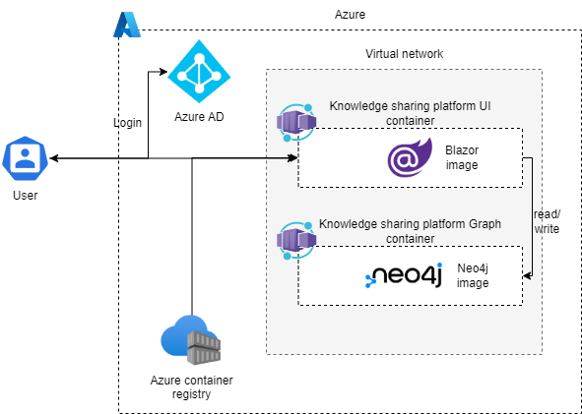
Architecture Diagram
Presentation Layer: Web application (Docker)
Business Logic Layer: Services for business logic
Persistence Layer: Neo4j database (Docker)
Single Sign-On Layer: Authentication and authorization
Container Orchestration Layer: Container management
Notes:
Presentation Layer: Web application containerized using Docker. Responsible for rendering the user interface and communication with other layers.
Business Logic Layer: Services implementing the application's business logic. Communicates with the persistence layer for data retrieval and persistence, and with the presentation layer for data exchange.
Persistence Layer: Neo4j database containerized using Docker. Responsible for data storage and retrieval. Communicates with the business logic layer for data access.
Single Sign-On Layer: Handles user authentication and authorization. Generates access tokens for application resource access.
Container Orchestration Layer: Manages application and database containers. Ensures container health, accessibility, and availability.

Slide 31
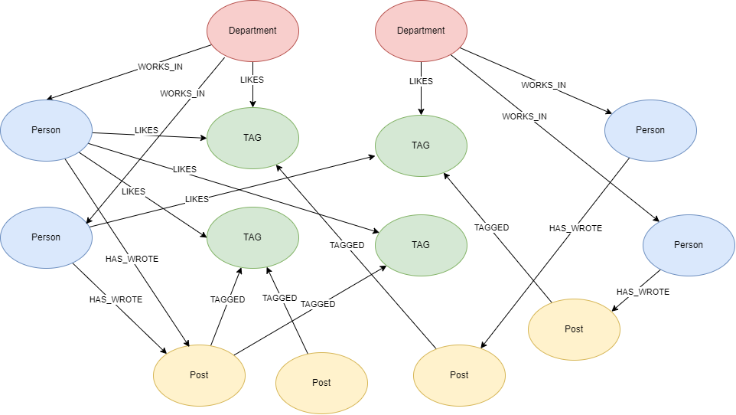
Graph database design
Nodes: Department, Person, Post, Tag
Relationships: One-to-many between nodes
Benefits: Quick tag searching for posts and recommendations based on liked tags
Efficient querying and searching with highly connected graph structure
Notes:
Four types of nodes: Department, Person, Post, and Tag
Relationships between nodes: one-to-many relationships between Department and Person nodes, Department and Tag nodes, Person and Post nodes, and Post and Tag nodes
Tag nodes connect with Department, Person, or Post nodes via "LIKES" or "HAS_TAGGED" relationships
Benefits of the graph database design: quick searching of tags for posts and recommendations based on liked tags
Efficient querying and searching due to highly connected graph structure

Slide 32
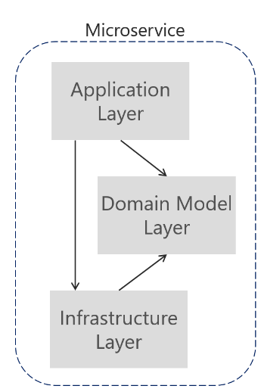
Layered architecture
Separation of concerns:
Focused layers for easier maintenance, cleanliness, and understanding
Role-specific modifications within each layer
Flexibility:
Independent layers for making changes without impacting others
Prevention of bugs and issues during layer modifications
Reusability:
Layers can be utilised by other applications with similar concerns and functionality
Increased testability:
Independent testing of each layer
Smaller, specific tests for individual application components
Notes:
Separation of concerns ensures focused layers, facilitating codebase maintenance, cleanliness, understandability, and role-specific modifications. Independence among layers enables flexibility, preventing bugs and issues when making changes to one layer without affecting others. Layers can be reused by other applications with similar concerns and functionality. Individual testing of each layer enhances testability, allowing smaller, specific tests to be written for each application component.

Slide 33
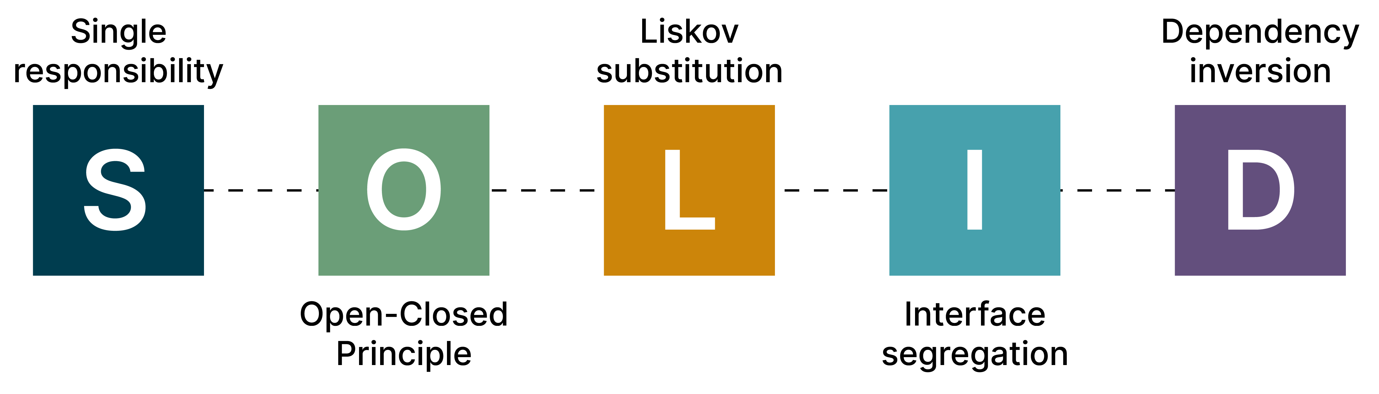
Coding standard Five Essential Design Principles (SOLID)
Notes:
Single Responsibility Principle (SRP)
Each class, module, or function should have a single responsibility.
Promotes better organization and maintainability.
Open Closed Principle (OCP)
Classes should be open to extension but closed to modification.
Enables flexibility and avoids code changes in existing classes.
Liskov Substitution Principle (LSP)
Subclasses should be interchangeable with their base classes.
Ensures substitutability and adherence to the expected behaviour.
Interface Segregation Principle (ISP)
Interfaces should be separated and focused on specific responsibilities.
Prevents clients from depending on unnecessary methods
Dependency Inversion Principle (DIP)
Interfaces should be separated and focused on specific responsibilities.
Prevents clients from depending on unnecessary methods

Slide 34
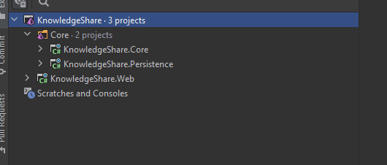

.NET application demonstration
Layered architecture
Notes:
Creating a .NET project with a layered architecture consisting of KnowledgeShare.Web, KnowledgeShare.Core, and KnowledgeShare.Persistence is a good design because it promotes separation of concerns, improves maintainability, and enhances testability of the application.

Slide 35
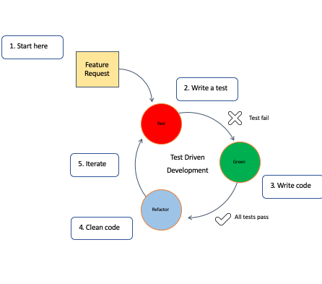
Test driven development
Understand requirements and write test case.
Write test from test case and run test so it fails.
Write implementation of functionality and rerun to test to pass.
Refactor code.
Repeat process for any

Slide 36
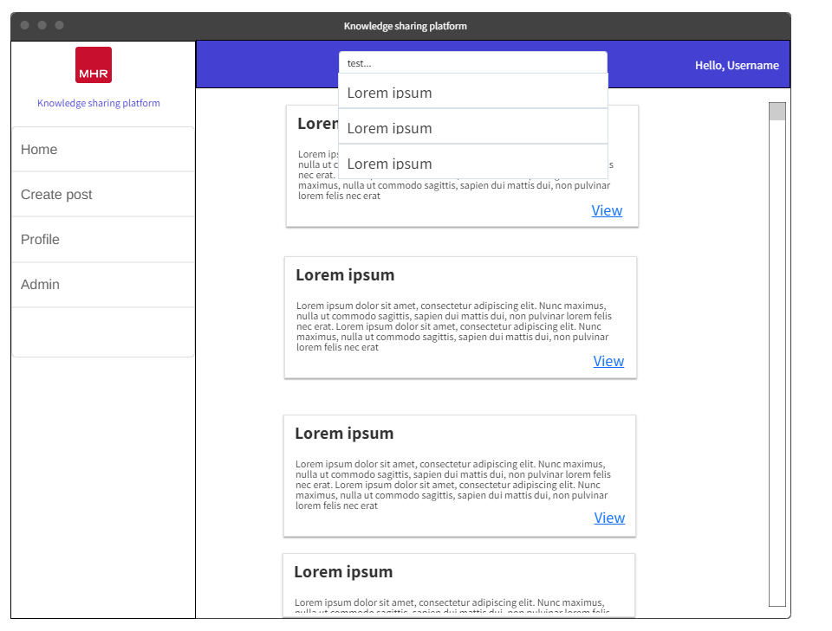
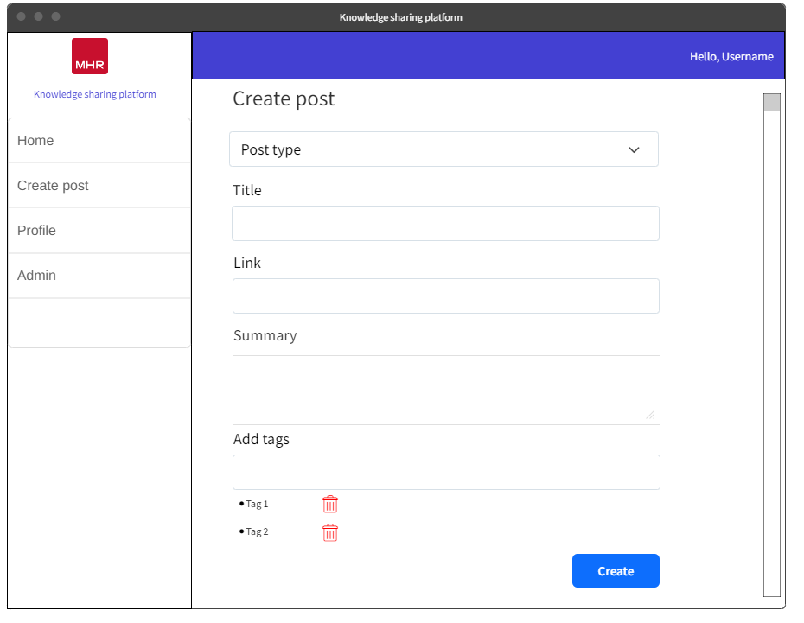
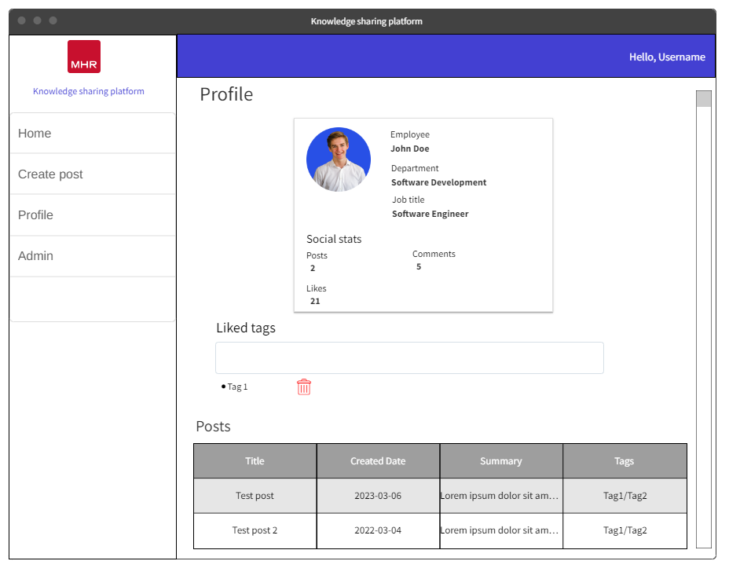
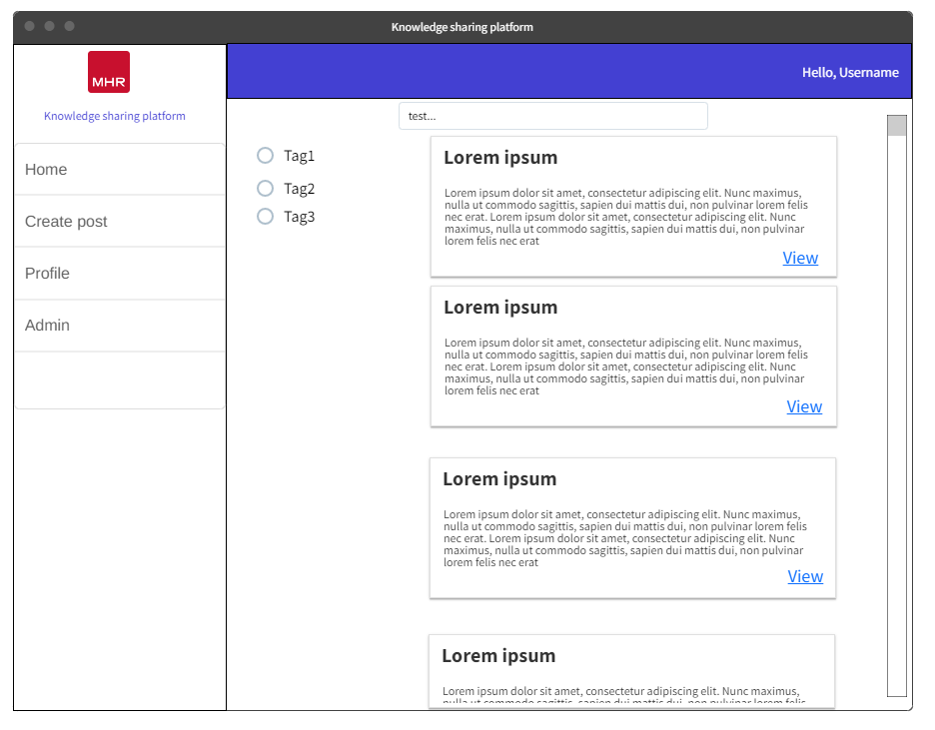
UX Designs
Wireframes were created for the UI.
These were then reviewed and had feedback from stakeholders in the project.
Prioritization of accessibility, simplicity, and inclusion
User-friendly interfaces and intuitive design principles
Integration of ethical principles for a responsible software development environment
Efficient and responsible user experience

Slide 37

Iterative development
Break down of each sprint and what was done

Slide 38
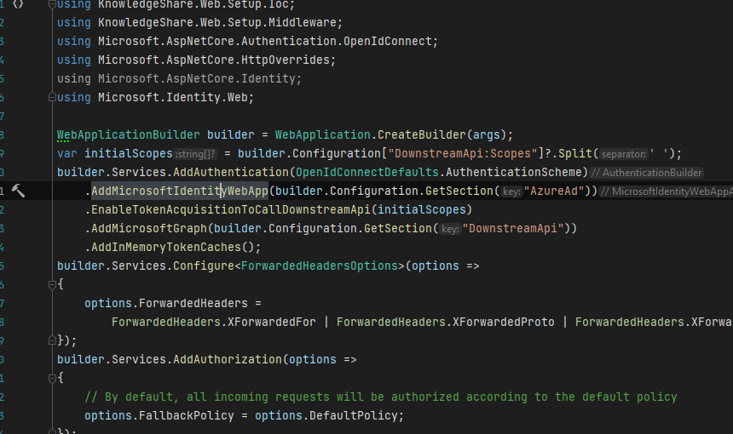
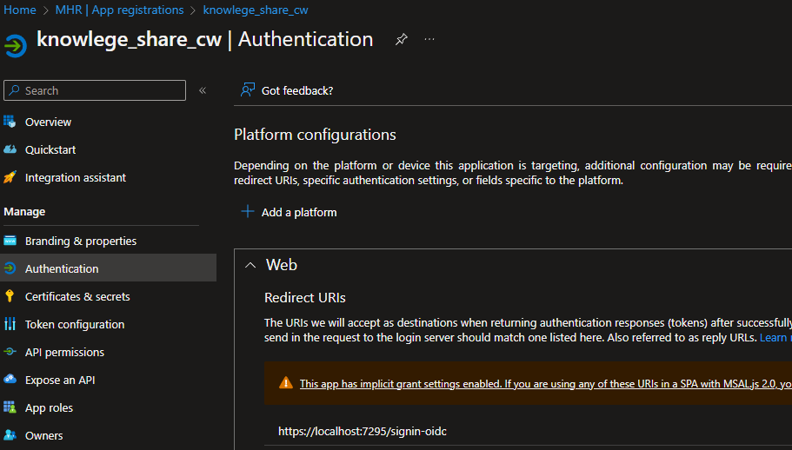
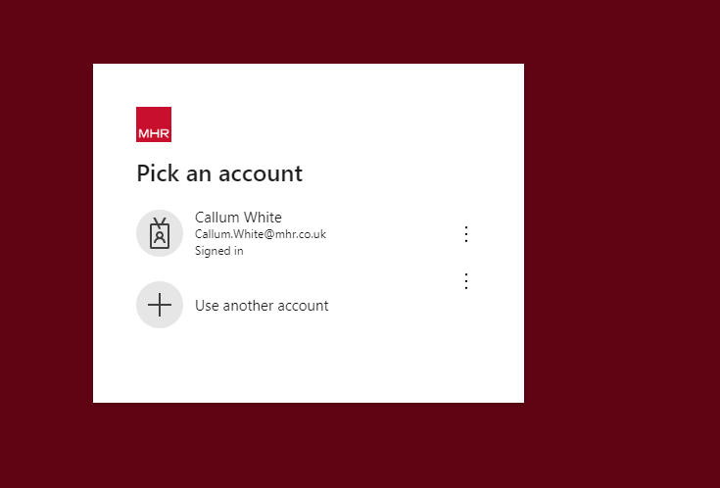
Sprint 1
Single sign on setup
Create app registration in Azure & provide the redirect URL
Setup authentication in .NET application startup project

Slide 39
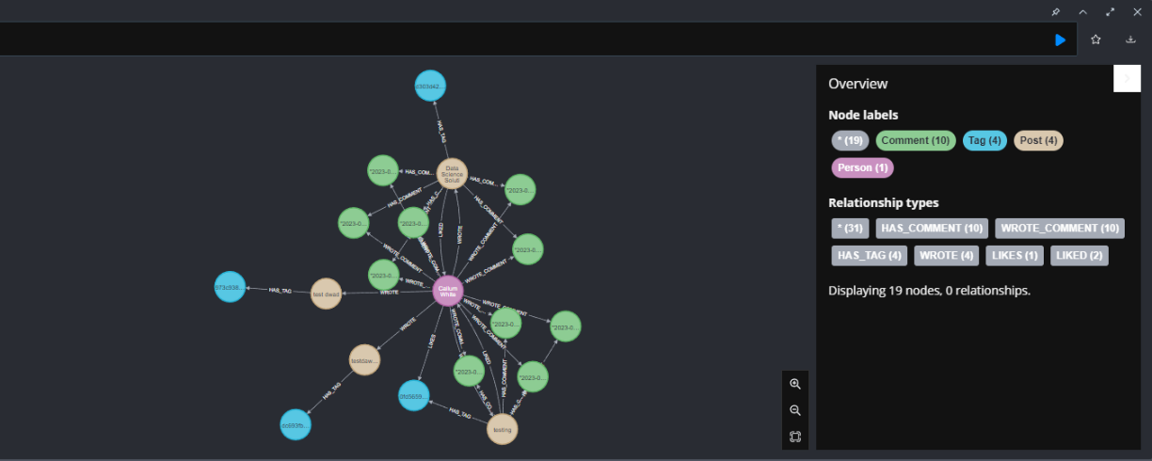
Sprint 1
The challenge in developing the graph database was configuring persistence layer for Neo4j. Setup involved installing Neo4j, establishing connection, and utilizing .NET driver.
Shows a graph of the data model within Neo4j database, this uses bloom that allows for queries to be directly ran on the database and shown visually
Notes:
The initial challenge in developing the graph database was configuring the application's persistence layer to interface with a Neo4j database. This involved installing Neo4j on the local machine and ensuring that the connection between the database and .NET application was properly established.
To set up the Neo4j driver in .NET, the team utilized NuGet to install the Neo4j .NET driver package to the .NET application. Additionally, they installed Neo4j Desktop to enable local database instance management and establish a connection to the database in their .NET application using the driver, specifying server address, port, and credentials.

Slide 40
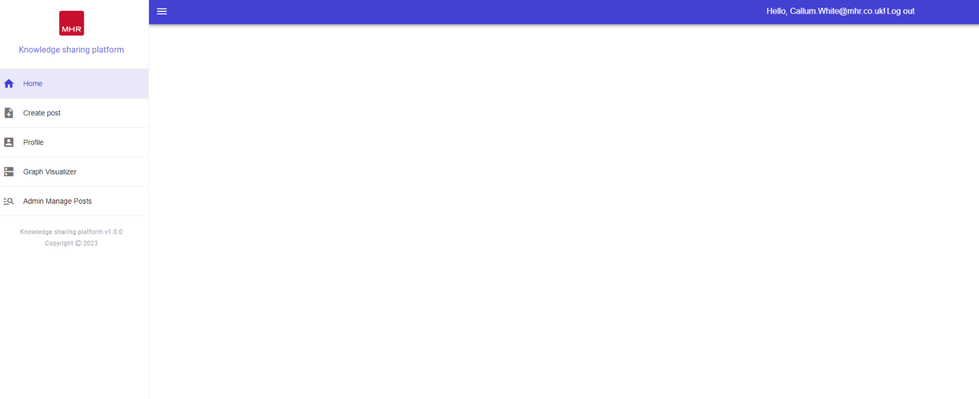
Sprint 2
Landing Page Overview:
Design a comprehensive landing page showcasing the application's functionality.
Incorporate interactive elements, like buttons and forms, for an engaging and user-friendly experience.
User Feedback and Implementation:
Incorporate user's full name instead of email as the username in the top right corner of the page, based on project sponsor feedback.
Utilize Microsoft Graph API to retrieve user information, including first and last name.
Challenges and Optimization:
Ensure landing page responsiveness and compatibility across various devices and browsers.
Optimize page performance to minimize load times and enhance overall user experience.

Slide 41
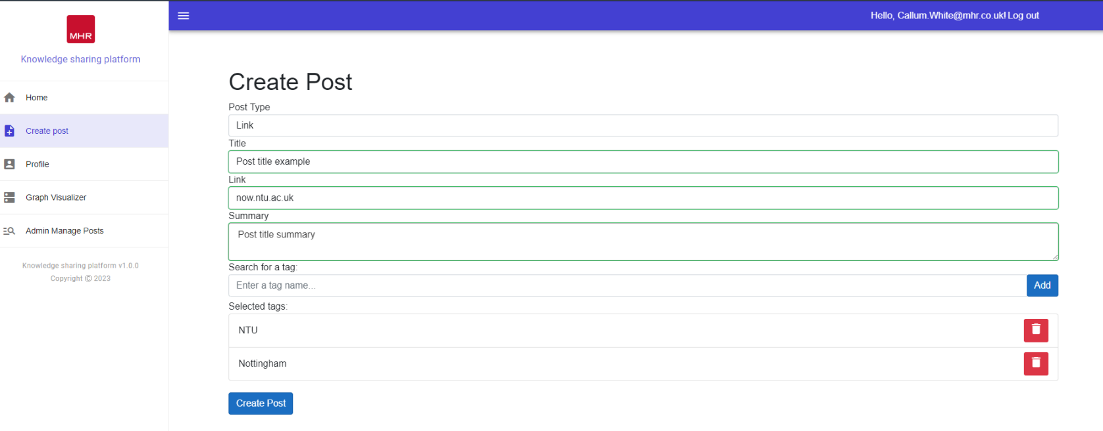
Sprint 2
Creating Post User Interface:
Design an intuitive and easy-to-navigate user interface for creating posts.
Implement the interface using the Blazor framework.
Post Creation Options:
Enable users to select the type of post they want to create (link, book, or free-form).
Collect necessary information based on the selected post type, such as title, summary, and URL for links and books, and free-form text for free-form posts.
Allow users to add tags to their posts.
Challenges with Blazor Implementation:
Overcome challenges related to form submissions, validations, and proper functioning.
Invest time in resolving issues to ensure correct form behavior.
User Interface with Tagging:
Incorporate a dynamic input box for users to add tags to their posts.
Provide functionality for users to delete tags from their posts.

Slide 42
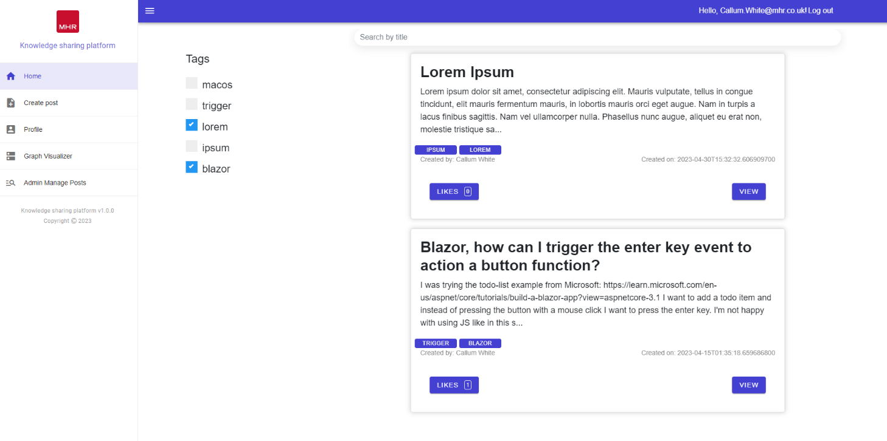
Sprint 2
Discovery

Slide 43
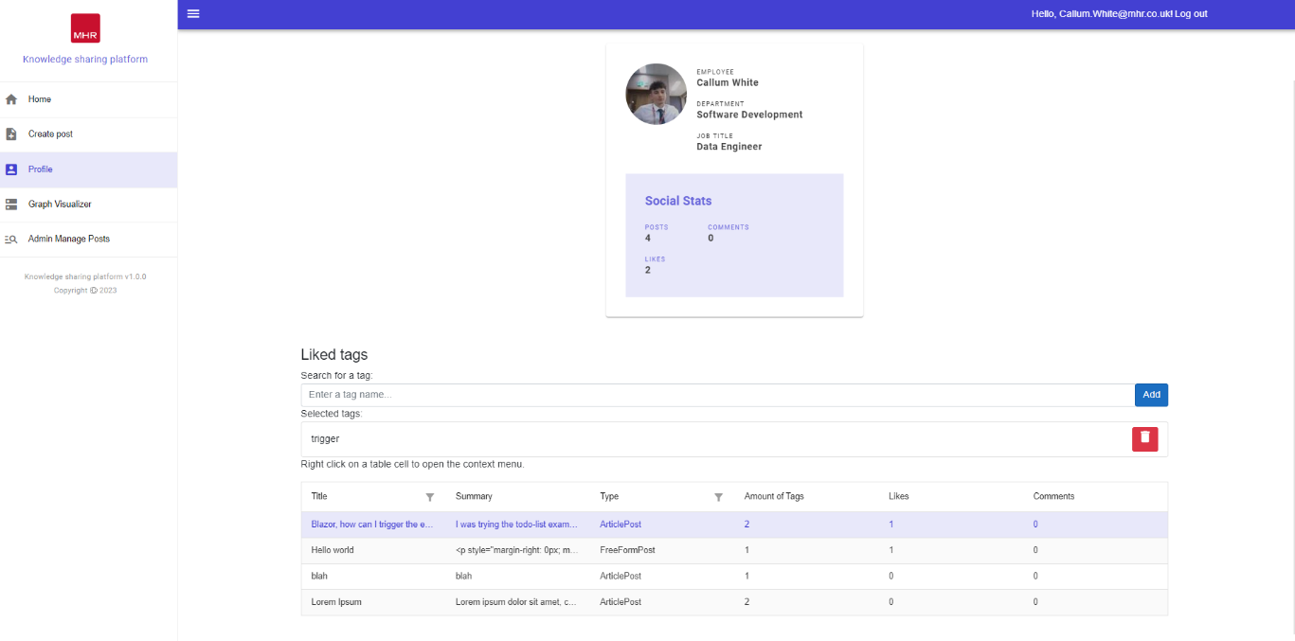
Sprint 3
Profile page

Slide 44
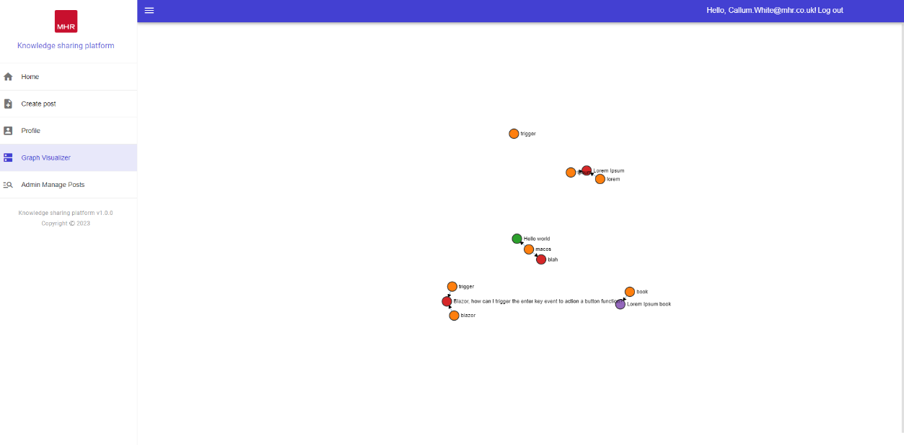
Sprint 3
Profile page

Slide 45
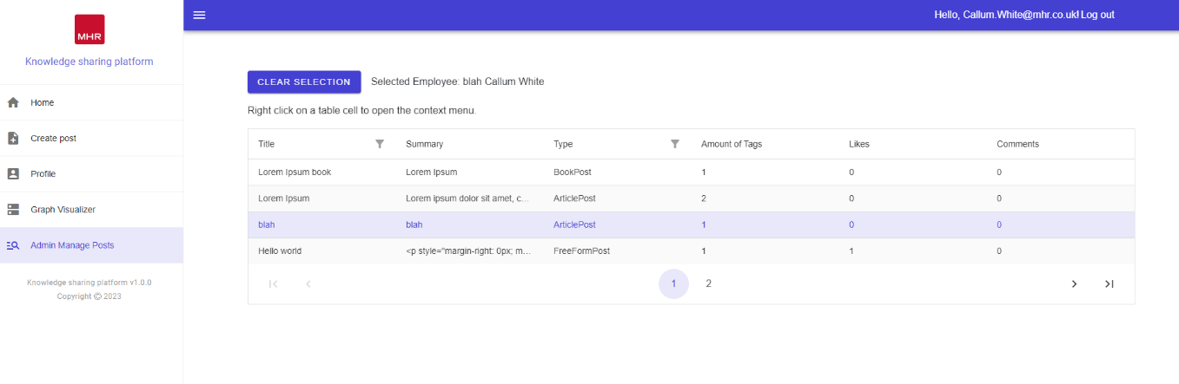
Sprint 3
Admin page

Slide 46
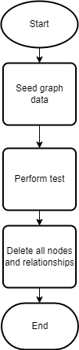
Unit & Integration test
Integration Testing Setup:
Separate Neo4j database created for testing
Does not impact the current Dev database for development purposes
Integration Testing Process:
Utilizes NUnit framework
Teardown functionality clears down Neo4j graph database after each test
Ensures idempotent tests that can be repeated multiple times within a session
Maintains test consistency

Slide 47
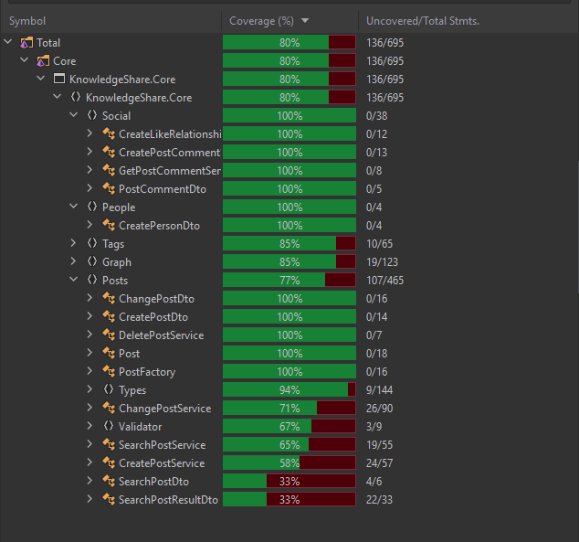
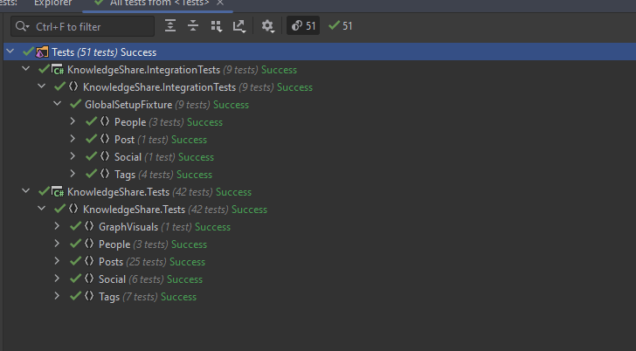
Unit & Integration test results

Slide 48
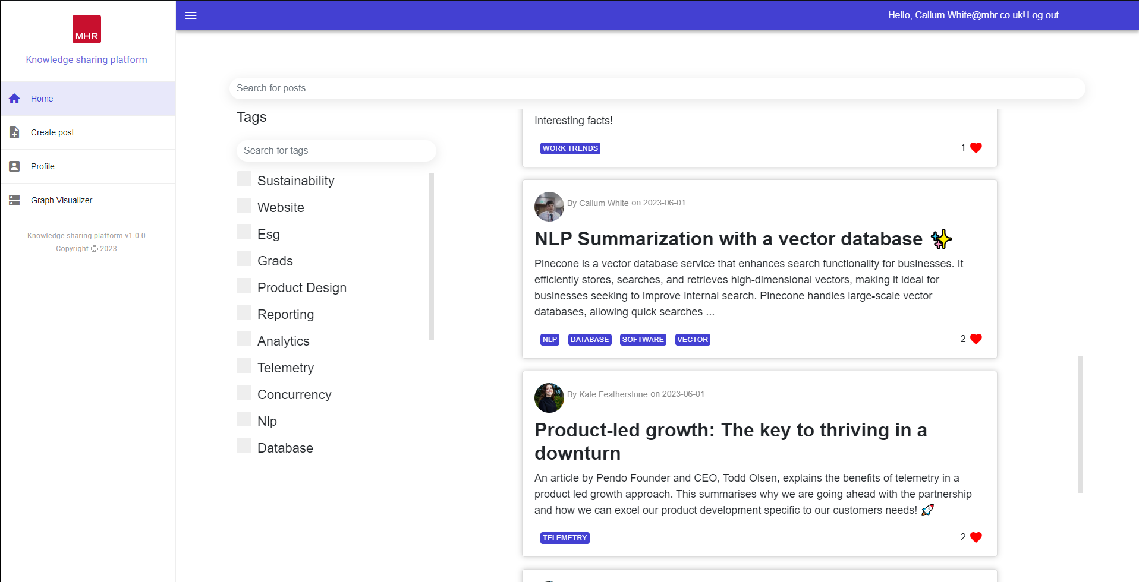
Live Demo of Knowledge sharing platform
Kate will be helping with the Demo

Slide 49
UI Feedback
User experience (UX) feedback must be incorporated into the knowledge sharing platform's iterative development process to improve the platform's usability and aesthetic appeal.
Notes:
User experience (UX) feedback must be incorporated into the knowledge sharing platform's iterative development process to improve the platform's usability and aesthetic appeal. In this review, a UX specialist within in the business offers insightful commentary on the platform's various pages' CSS styling. Their suggestions centre on maximising screen space, achieving visual harmony, upholding consistency, and enhancing user experience overall.

Slide 50
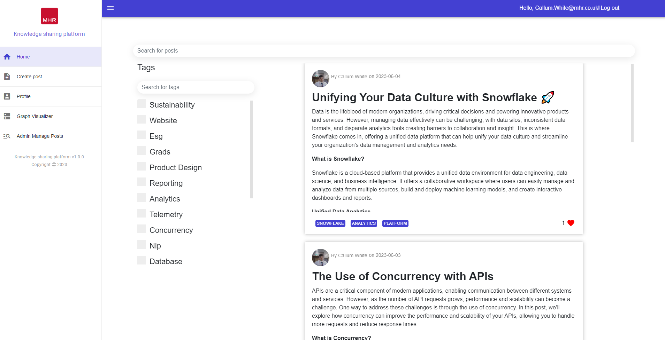
Discovery page
Notes:
Padding Reduction at the Bottom of Cards: To optimize screen real estate and achieve a more visually balanced layout, it is recommended to decrease the padding between the content of the cards and the bottom edge. This adjustment will create a more compact design while maintaining the necessary breathing space.
Background Removal and Lowercasing of "Likes": To maintain a consistent and modern typographic style, our UX expert suggests removing any background element behind the likes count on the cards. Additionally, they recommend using lowercase letters for the word "likes." These changes will contribute to a cleaner and more streamlined appearance.
Alignment of Likes with Info Detail: To enhance the visual hierarchy and overall alignment, aligning the likes count with the accompanying information details on the cards is advised. This adjustment will result in a more organized and visually pleasing layout, improving the overall user experience.
Removal of "View" Button for Post Access: To simplify the user interface and streamline the navigation, our UX expert proposes removing the "View" button that allows users to access the full post from the discovery page. Instead, it is suggested to make the entire card clickable, enabling users to navigate to the post by clicking anywhere on the card.
Use of Light Grey Colours for Tags: For an aesthetically pleasing design and reduced visual distractions, our colleague suggests utilizing light grey colours for the tags on the discovery page, replacing the current blue. This adjustment will create a more subdued and harmonious colour palette, allowing the primary content to stand out effectively.

Slide 51
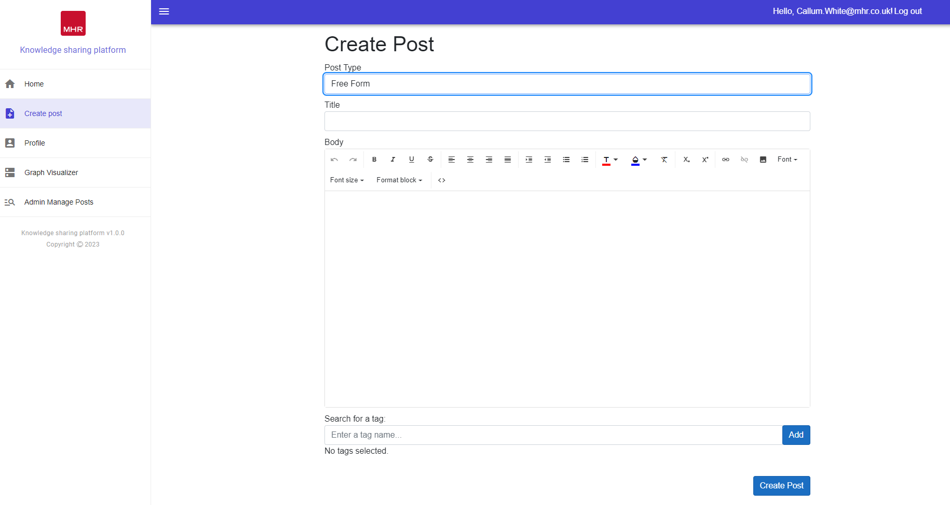
Create post page
Notes:
Padding Reduction at the Bottom of Cards: To optimize screen real estate and achieve a more visually balanced layout, it is recommended to decrease the padding between the content of the cards and the bottom edge. This adjustment will create a more compact design while maintaining the necessary breathing space.
Background Removal and Lowercasing of "Likes": To maintain a consistent and modern typographic style, our UX expert suggests removing any background element behind the likes count on the cards. Additionally, they recommend using lowercase letters for the word "likes." These changes will contribute to a cleaner and more streamlined appearance.
Alignment of Likes with Info Detail: To enhance the visual hierarchy and overall alignment, aligning the likes count with the accompanying information details on the cards is advised. This adjustment will result in a more organized and visually pleasing layout, improving the overall user experience.
Removal of "View" Button for Post Access: To simplify the user interface and streamline the navigation, our UX expert proposes removing the "View" button that allows users to access the full post from the discovery page. Instead, it is suggested to make the entire card clickable, enabling users to navigate to the post by clicking anywhere on the card.
Use of Light Grey Colours for Tags: For an aesthetically pleasing design and reduced visual distractions, our colleague suggests utilizing light grey colours for the tags on the discovery page, replacing the current blue. This adjustment will create a more subdued and harmonious colour palette, allowing the primary content to stand out effectively.

Slide 52
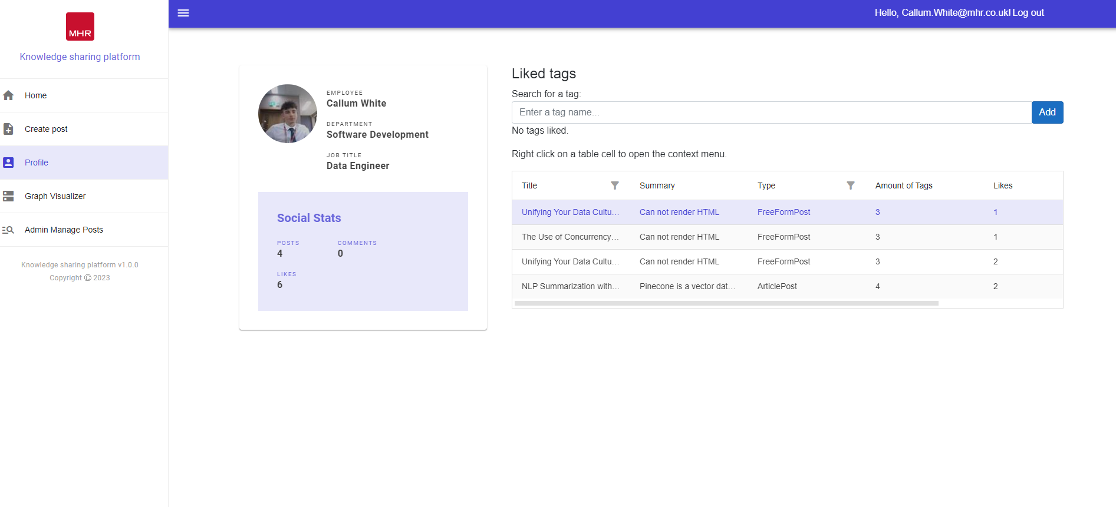
Profile page
Notes:
Padding Reduction at the Bottom of Cards: To optimize screen real estate and achieve a more visually balanced layout, it is recommended to decrease the padding between the content of the cards and the bottom edge. This adjustment will create a more compact design while maintaining the necessary breathing space.
Background Removal and Lowercasing of "Likes": To maintain a consistent and modern typographic style, our UX expert suggests removing any background element behind the likes count on the cards. Additionally, they recommend using lowercase letters for the word "likes." These changes will contribute to a cleaner and more streamlined appearance.
Alignment of Likes with Info Detail: To enhance the visual hierarchy and overall alignment, aligning the likes count with the accompanying information details on the cards is advised. This adjustment will result in a more organized and visually pleasing layout, improving the overall user experience.
Removal of "View" Button for Post Access: To simplify the user interface and streamline the navigation, our UX expert proposes removing the "View" button that allows users to access the full post from the discovery page. Instead, it is suggested to make the entire card clickable, enabling users to navigate to the post by clicking anywhere on the card.
Use of Light Grey Colours for Tags: For an aesthetically pleasing design and reduced visual distractions, our colleague suggests utilizing light grey colours for the tags on the discovery page, replacing the current blue. This adjustment will create a more subdued and harmonious colour palette, allowing the primary content to stand out effectively.

Slide 53
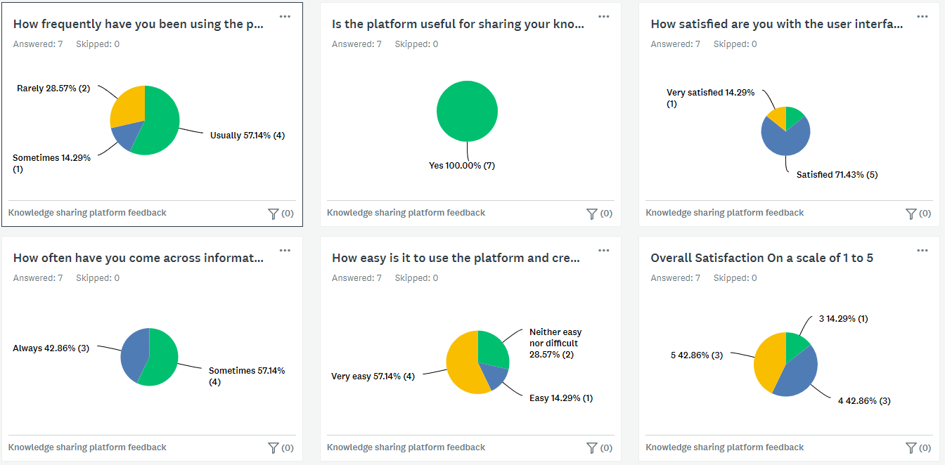
Knowledge sharing feedback
Notes:
The feedback survey results showed consistent findings with the literature on knowledge-sharing platforms. Users expressed positive sentiments and reported frequent usage of the platform. They were highly satisfied with the user interface and overall experience. The survey indicated effective cross-departmental collaboration, with users frequently encountering information shared by other departments. Most users found the platform easy to use, and overall satisfaction ratings were positive. These findings support the successful facilitation of collaborative sharing and the reduction of departmental silos. The survey results align with previous research on knowledge-sharing platforms, specifically with Deloitte's D Street case study, which reported increased knowledge-sharing, improved content quality, and reduced duplication. Overall, the survey confirms the platform's positive impact on collaboration, productivity, and innovation.

Slide 54
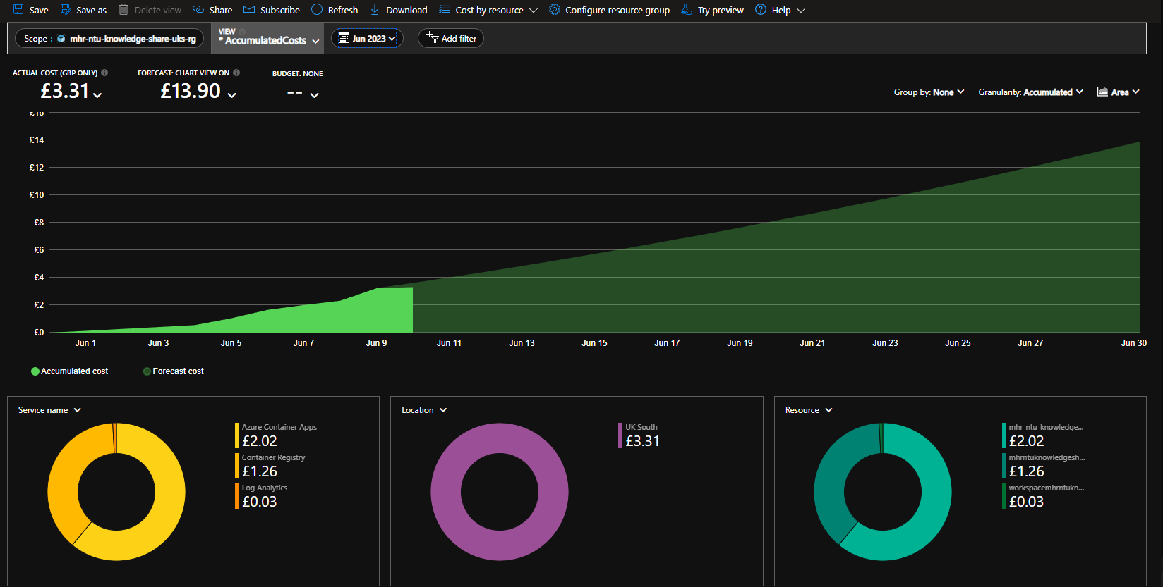
Hosting Cost Analysis
Azure Cost Analysis of Knowledge Sharing Platform
Forecasted hosting cost: £13.90
Cost growth varies with user numbers, not linearly.
Leveraging Kubernetes for resource optimization and scaling.
Comparison with Nuclino Platform:
Knowledge sharing platform: £13.90
Nuclino platform: £40,800.00
Demonstrates superior affordability of internal platform.

Slide 55
Future work Future Functional Requirements
Notification System for Updates and Activity:
Real-time notifications via email, push, or in-app alerts.
Enhance user engagement and keep users updated.
User-Following Functionality:
Enable users to follow others for community and connection.
Stay connected with posts from followed users.
Integration with External Social Media Platforms:
Share platform content to external social media.
Extend content reach and encourage broader discussions

Slide 56
Future work Potential Improvements
Abstract Logical Tier into an API
Separate web application's logical tier into a REST API.
Improve codebase management, scalability, and maintenance.
Implement Playwright for Automated UI Testing
Utilize Playwright for robust UI testing.
Identify UI issues and validate user interactions
Enhanced Analytics Capabilities
Provide detailed insights into user behavior and content performance.
Use data to refine platform effectiveness.

Slide 57
Thank you

Slide 58
Q&A

